Slide 1







WHAT YOU NEED TO KNOW
ABOUT WORKING IN A
LAB-
GENERAL LAB ORGANIZATION
Dr. Fern Tsien Department of Genetics LSUHSC

Slide 2
What type of laboratory do
you work in?
In general, labs can be described as:
  Basic Science – the researchers do science for the sake of knowledge. For example, how does a specific transcription protein work ?
  Clinical research – human patients or their samples are used to investigate a disease or syndrome.

Slide 3
Where is your lab located?
Each lab is part of a Department or Center.
Large pieces of equipment are often shared by the department members and are housed in a separate lab or possibly your lab.
These can include ultra-cenrifuges, liquid
nitrogen tank, autoclaves, dark rooms, etc.
Also the department may have a conference room and a kitchen.
Make sure you check if you can use these facilities before going ahead.

Slide 4

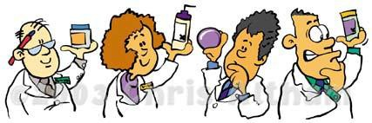
KNOW YOUR LAB COWORKERS

Slide 5
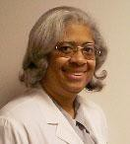
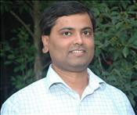
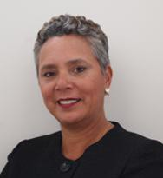

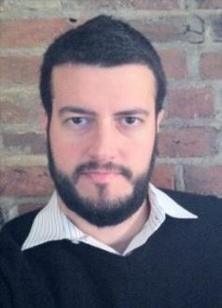
Principal Investigator (PI)
People often ask: Who is your PI?
This is the head of the lab, the boss, your
advisor. Most probably your mentor.
This person often spends time in their office writing grants or research reports and may spend less time in the lab.
If they are clinicians, they may also see
patients in addition to report writing.
However, this person is the intellectual guide behind most of the projects in the lab
PIs are responsible for funding the lab research.

Slide 6
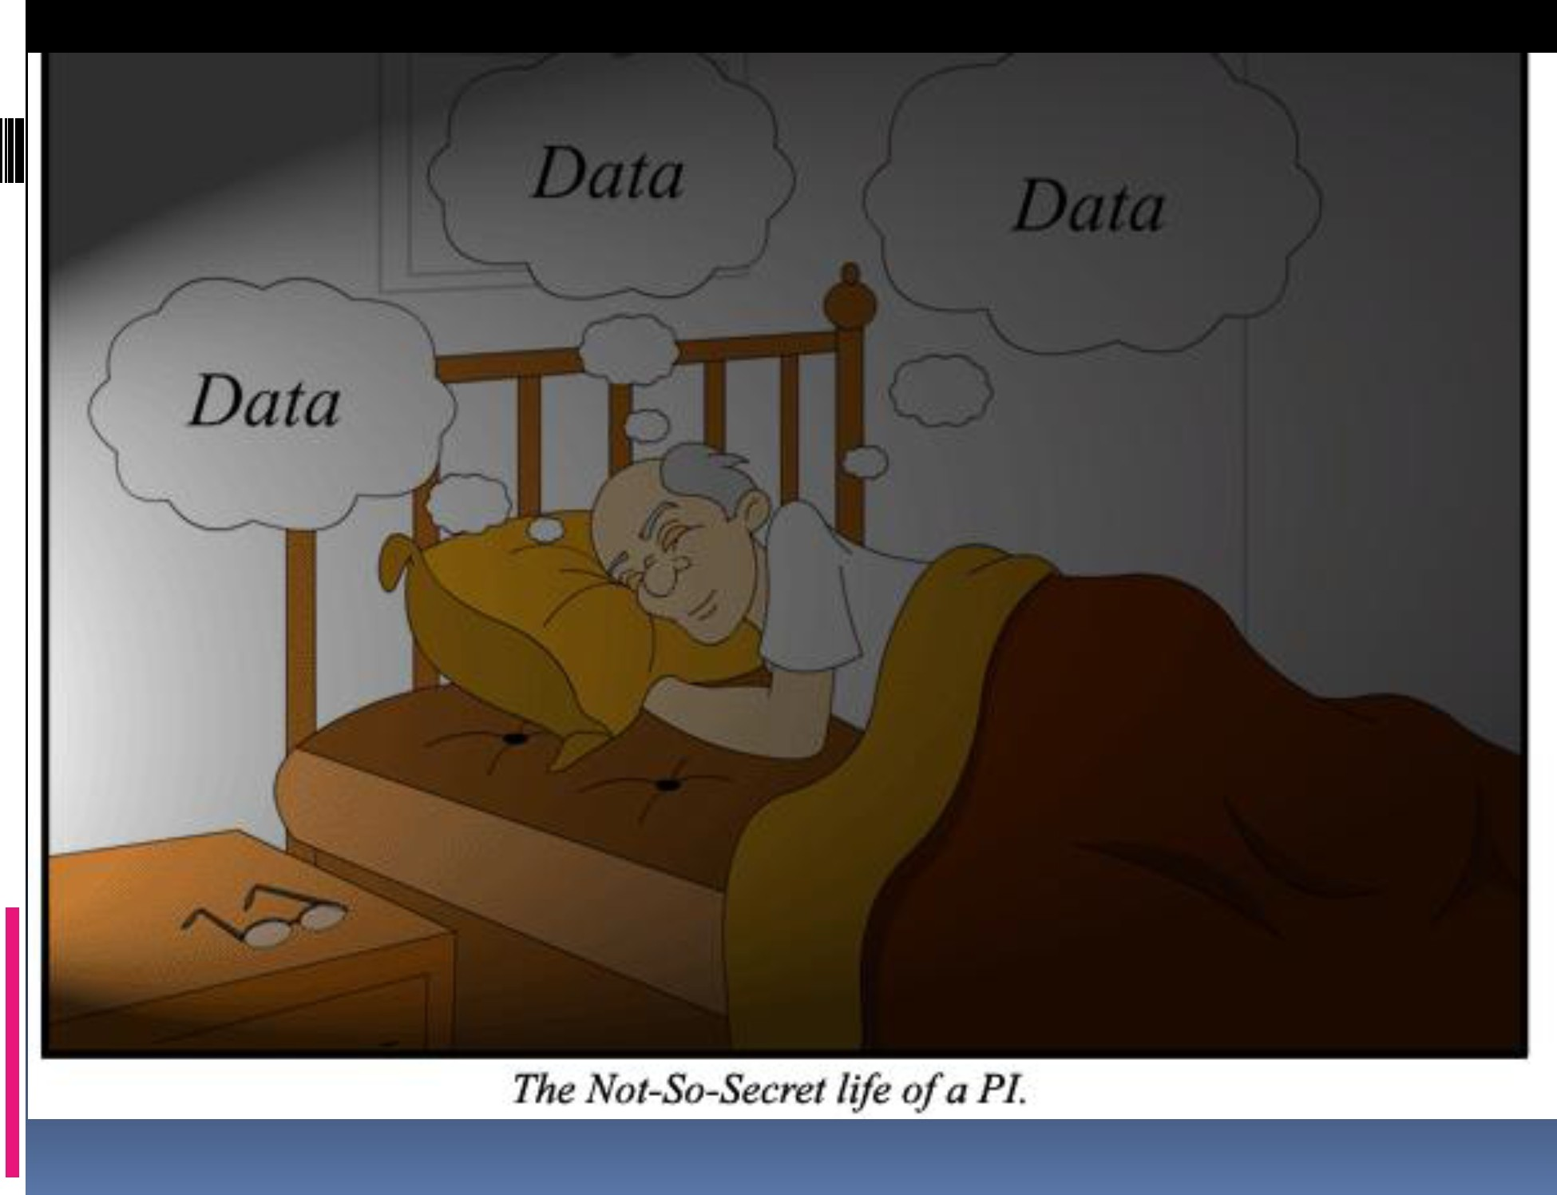
•_{I}
I

Slide 7
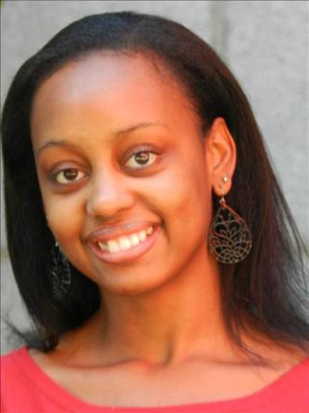
Post docs
Lab Post-doctoral fellow
This person has recently received their doctorate (usually PhD) and is doing a training period before becoming a PI
They usually work on their own project, but will collaborate with other lab members on various parts of the project.

Slide 8

Technician or research
assistant
Can be a college student who wants to gain more experience in a lab before entering medical or graduate school
Can be a professional with a masters degree and appropriate pay and title, based on years of experience
They do a variety of tasks including: ordering lab supplies, preparing media, caring for the lab’s cell lines, assisting the lab with experiments, and they can carry their own experiments.

Slide 9
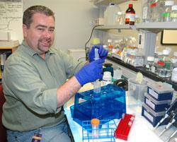
Lab supervisor
The day-to-day operation of the lab is
sometimes overseen by a lab supervisor.
This person usually has a masters degree and extensive lab experience.

Slide 10

Graduate students
They are doing lab work to get
their Masters degree or PhD.
They usually work long hours and spend a lot of time invested in their specific project.
They become increasingly independent during their 4-5 years in the lab.

Slide 11
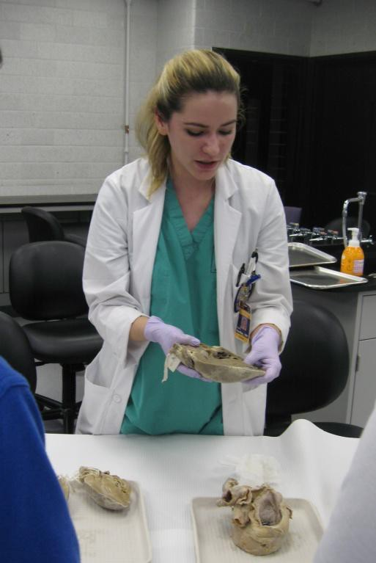
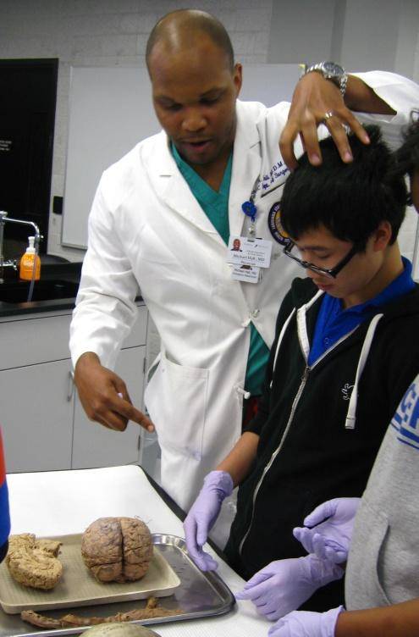
Residents and fellows
They have an MD and are spending some time (weeks, months, sometimes years) training in an area of his/her field before they become independent

Slide 12
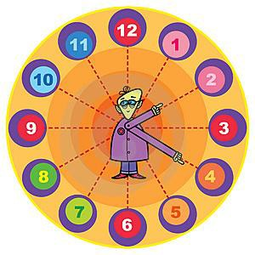
Working hours
Because experiments do not fit into a slot of 9-5, lab workers have unpredictable and sometimes eccentric hours. This does not apply to you!
Clinical research also depends on the clinic schedule.
Check with your mentor what working hours are
expected of you and try to conform to this.
Please communicate with your mentor and lab personnel what your vacation plans are.
If you are sick, please let them know.
Even though you do not get paid by the hour, you need to let them know out of courtesy.

Slide 13
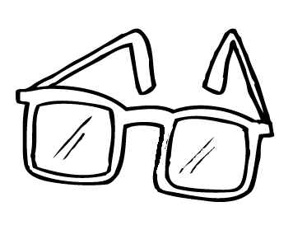
Lab meetings
Large labs usually have meetings to discuss the research of
each member of the team.
In these meetings, sometimes only one or two people are assigned to talk each week, or all members are expected to speak briefly.
Some meetings are casual, and some are formal with a slide
projector.
You may be asked to participate. Ask your mentor ahead of time if he/she expects you to participate so you can prepare a few statements or questions you may have.
Check out the atmosphere and ask questions during appropriate times.
DO : take notes and look up terms you may not
understand
DO NOT: fall asleep, text message during the meeting

Slide 14

The first week
By now you should have been assigned a desk
or lab bench.
Your mentor should have discussed your project with you.
If another lab member offers to teach you, go
ahead and learn from them.
You may get a lab key. Be careful with it!
Your research may be slow right now while you wait for reagents to be ordered, cells to grow, etc.

Slide 15
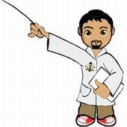
What to do on the
first few weeks
Set up and organize your lab bench or desk
Introduce yourself to everyone in the lab if the mentor has not done so.
TAKE NOTES ON EVERYTHING!You do not want your instructors to keep repeating themselves or they will get annoyed.
Familiarize yourself with where things are kept.
ASK. Of course, you do not want to bother anyone unnecessarily, but it is much better to ask about a procedure, a reagent, equipment, etc. than to wasted time and money.
If you make a mistake, it’s OK. Just make sure you learn and
ask coworkers for help.
Ask your mentor for relevant literature about the project. This will impress them!

Slide 16

What NOT to do on your
first few weeks
Don’t say “we did not do it this way in my previous job”. Each lab does experiments their own way (example: cell culture)
Do not prop up your feet and read, play computer games, take a nap, or look at videos onYoutube. It is true that at the beginning, there will be some dead (non-experiment) time until the experiment takes off. However, playing while others are working hard will not make a good impression. Instead try to read about your research topic.
Do not ask and/or complain to other students or co-workers about money
or salaries. It can irritate mentors and other co-workers.
Don’t say you are working in a lab for any other reason than for interest in the field. If you say you are working there just for the money, you will not be taken seriously and it can cost you your job.

Slide 17
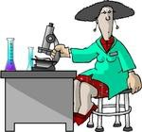
Basic survival rules:
Attitude
Ask, do not command. Others are taking the trouble to help you and do not HAVE to do it.
Be courteous to everyone, not just your mentor.
Do not assume that someone is going to drop what
they are doing to help you. Be patient.
Write down everything when someone is giving you instructions. You are not expected to remember everything, and that person is not expected to repeat everything over and over again.
Make appointments with busy people. Some mentors are also directors of a department or center, and are hard to know when they are available for them to focus on what you have to say.

Slide 18
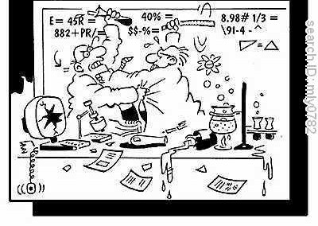
Basic survival
rules: Courtesy at
Science Friction
the lab bench
Do not use reagents in someone else’s lab bench without asking.
If everyone shares a reagent and you finish it, let someone know. Do not place the empty bottle back on the shelf.
If something breaks, tell someone immediately.You will not get in trouble unless you try to hide it.
If you do something wrong, confess. Everyone makes mistakes, but sneaking to cover a mistake is unacceptable.
Clean up after the experiment. Do not leave it for the technician or graduate student to do it.

Slide 19
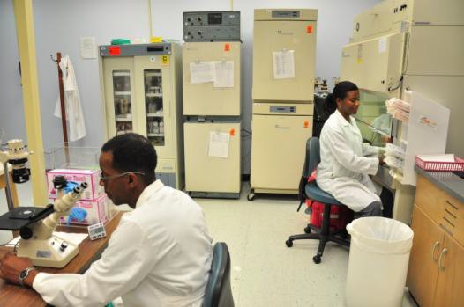
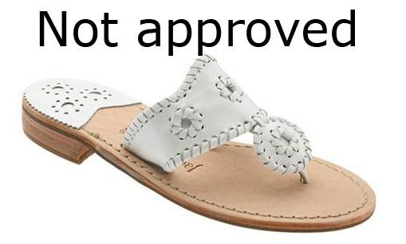
Check your lab’s own Safety
rules
No eating, drinking, or smoking in the lab unless
approved by your mentor.
Do not wear open toed shoes in the lab. Your feet will be vulnerable if a chemical spills on you.
No shorts or bare midriffs are allowed for safety
reasons.
Do not mouth pipet, even water.
Ask what to do in case of emergency-where the first aid kit is kept, how to call for emergency

Slide 20
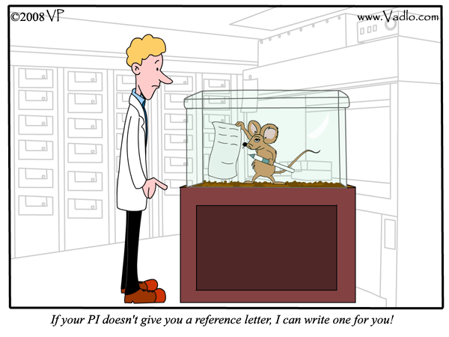

Slide 21



If you have any questions or
problems, please make sure to let
us know early on in the internship.
Dr. Paula Gregory Dr. Fern Tsien
pgrego@lsuhsc.edu fmille@lsuhsc.edu

Slide 22
TODAY’S EXPERIMENT

Slide 23
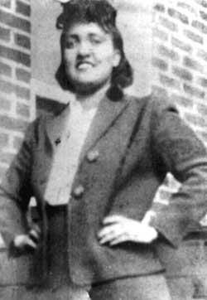
What are HeLa Cells?
HeLa cells are cervical cancer cells that were
obtained form a woman named Henrietta Lacks.
These cells were obtained from a biopsy of the cervix by her doctor without her knowledge/consent.
The cells were immortalized.
Henrietta
Lacks

Slide 24
Immortalized cells and HeLa
HeLa cells obtained from the biopsy are still alive and have been useful in the understanding of cancer and disease, as well as discovery of treatments and therapy.
HeLa was the first cell line immortalized
Was used in the development of polio vaccine, and to find link between human papilloma virus (HPV) and cervical cancer

Slide 25
The Immortal Life of Henrietta
Lacks
by Rebecca Skloot
Little was know about Henrietta Lacks until recently.
Recently, R Skloot wrote the biography of Ms. Lacks:
  Poor African American woman from Baltimore
  Had 5 children
  Had cervical cancer
  Had little understanding of her diagnosis of cervical cancer, and no knowledge of what the doctor at Johns Hopkins was planning to do with her biopsy.
Died of cancer in 1951 less than a year after diagnosis

Slide 26
Ethical implications
Most widely used and propagated cell type used for
research.
Billions of dollars in treatment and therapy discoveries by researchers and pharmaceutical companies
Last year, the National Institutes of Health (NIH) made an agreement with the Lacks family
The Lacks family agreed to allow researchers to have limited access to her DNA sequence
Lacks family has control over her information

Slide 27
New regulations
Currently, there are specific regulations for ensuring patient confidentiality and to allow patients to give consent to use their cells for research.
Cells are not allowed to be used for research
without the patient consent.

Slide 28

HeLa in the news
“The HeLa Genome: An Agreement on Privacy
and Access”; Statement released by the NIH
HBO to film movie by Oprah Winfrey

Slide 29
Today’s experiments:
Learn how to micropipette
HeLa and normal DNA
PCR analysis for the detection of human papilloma virus (HPV)
Gel electrophoresis

Slide 30
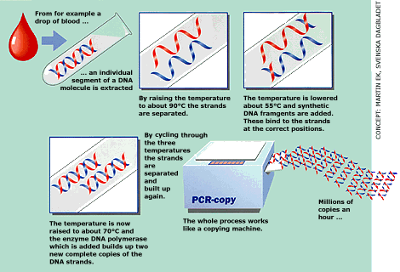
What is PCR?
The polymerase chain reaction (PCR) is a fast technique used in many labs to "amplify“ or copy small segments of DNA.
It is one of the most important scientific advances in molecular
biology.
Its creator, Kary B. Mullis, was awarded the Nobel Prize for Chemistry in 1993.

Slide 31
What is PCR used for?
Once amplified, the DNA produced by PCR (PCR product) can be used in many different laboratory procedures.
DNA fingerprinting in forensics and paternity testing
Detection of bacteria or viruses (HIV/ AIDS)
Diagnosis of genetic disorders
Many types of research!

Slide 32
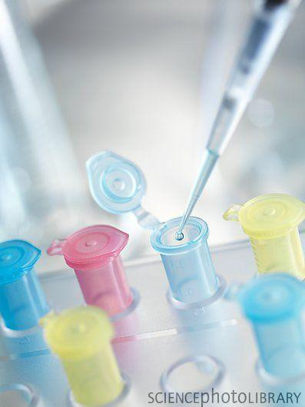
PCR: Polymerase Chain Reaction
Used to make millions of exact copies of
DNA from a biological sample
Allows very small samples to be analyzed,
such as a sample of a few skin cells
Must be very careful about contamination in
this process

Slide 33
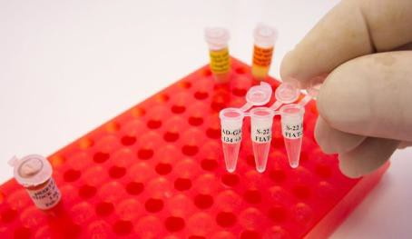
Inside the PCR reaction tube:
DNA that you want to
analyze
Primers (little pieces of DNA that define the area that you want to analyze)
Nucleotides (A, T, C, G)
Taq polymerase (drives this
entire reaction)
Magnesium, salts, etc. (for solution stability)
Sterile distilled water

Slide 34
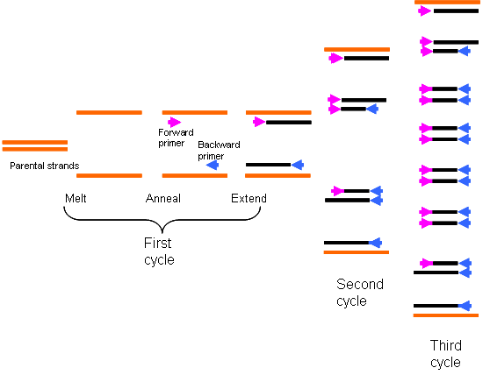
The DNA is | amplified millions | of
times in a | PCR machine
Millions of
DNA copies
95°C
45°C
72°C
The PCR machine heats and cools the DNA, primers, and other reagents in the tube and allows the amplification to take place.
This results in millions of copies.

Slide 35
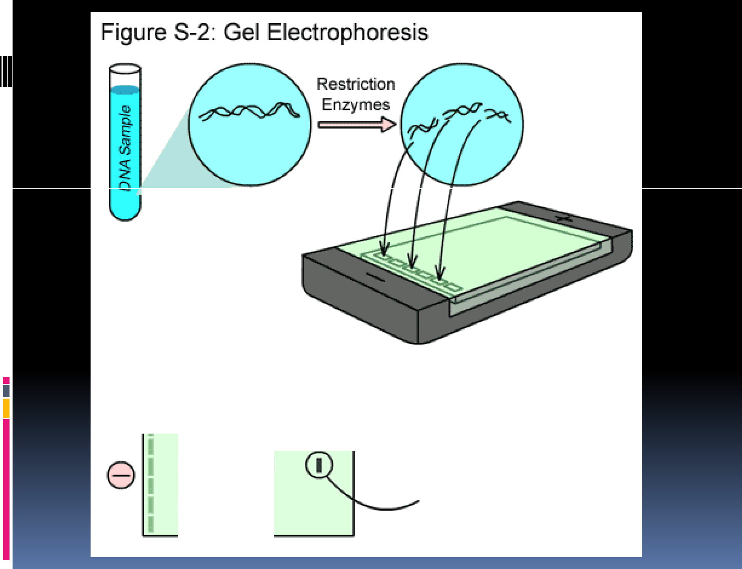

1. Restrjction enzymes cleave
DNA into smaJmer segments
of various sizes.
2. DNA segments are
loaded into wells in a
porous gel. The gelfloats in
a buffer solution within a chamber
between two electrodes_
3. wnen an electric current is passed through the chamber.
_{EB} DNA fragments move toward
tile posilively--cilarged calhode.
111
I
II I
II
4 . SmallIer DNIA segments move faster and fa.riheir than larger DNA segments_

Slide 36
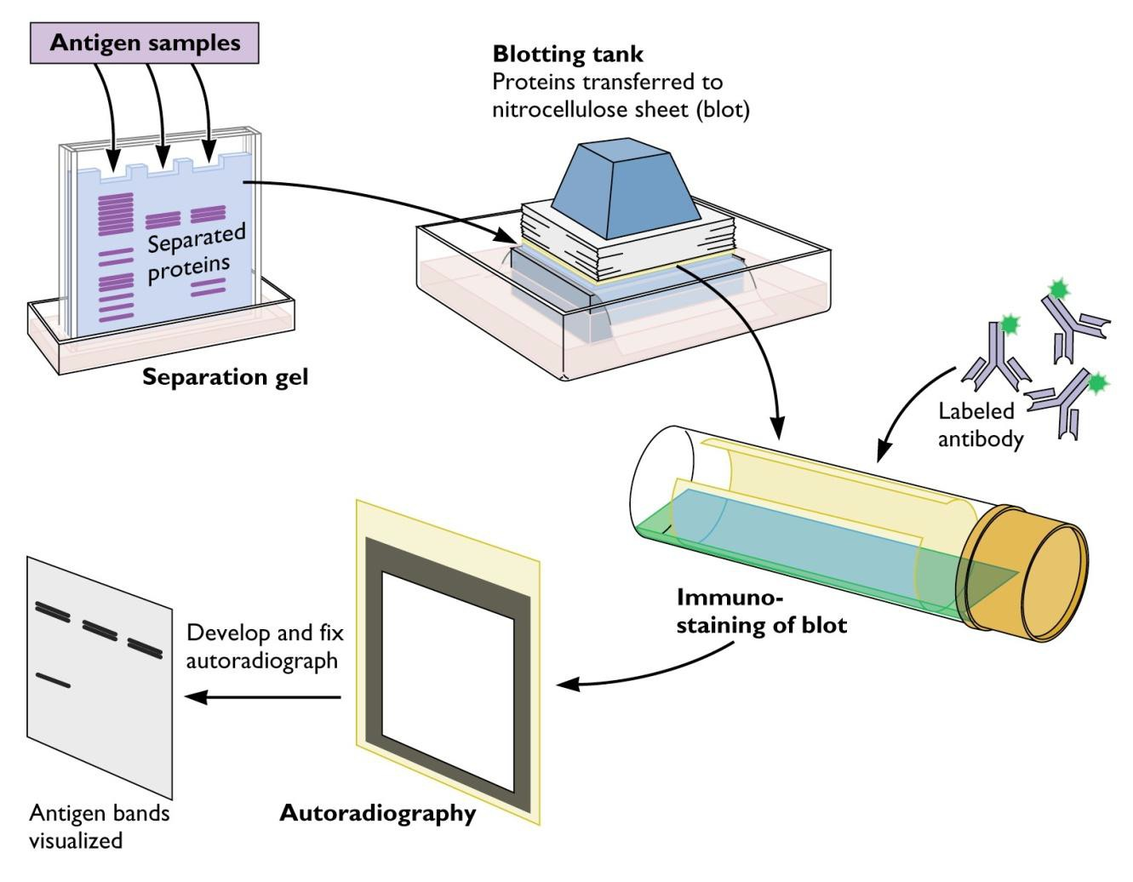
Variations of PCR and gel
electrophoresis
RT-PCR
Q-PCR
Western blots
Northern
blots
Etc….

Slide 37
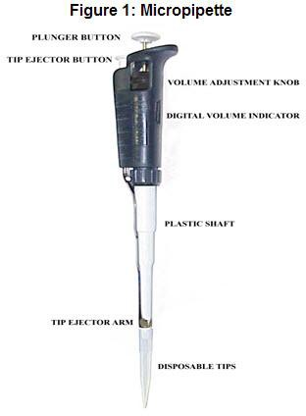
THE MICROPIPETTE

Slide 38
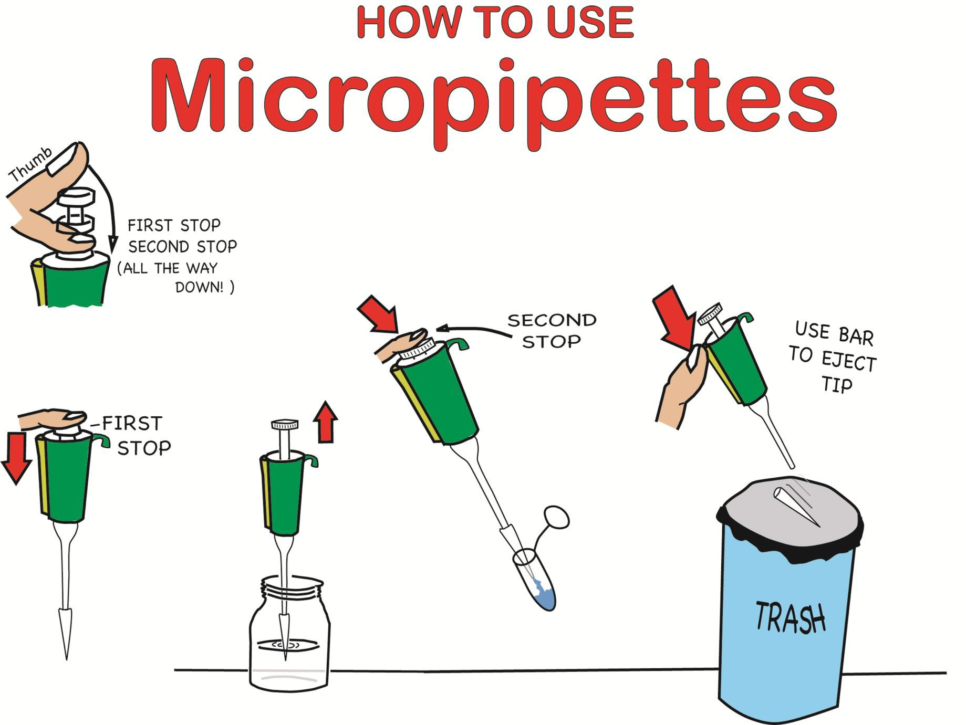

Slide 39
warnings about gel
electrophoresis:
THE POWER SUPPLY GENERATES AN ELECTRIC CURRENT. DO NOT IMMERSE YOUR HAND IN THE BUFFER OF THE GEL APPARATUS WHILE THE POWER SUPPLY IS CONNECTED AND TURNED ON.
UV LIGHT DAMAGES EYES. MAKE SURE TO KEEP THE UV TRANSILLUMINATOR LID DOWN TO LOOK AT GEL. MAKE SURE NOT TO OPEN THE LID WHILE THE UV LIGHT IS TURNED ON.

Slide 40
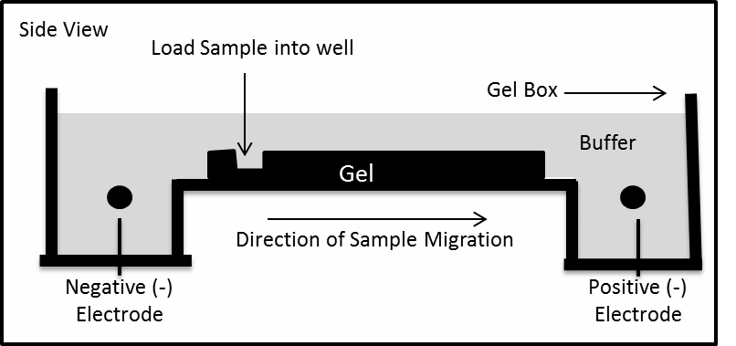
Gel electrophoresis
Remove the gel combs and dams.
Arrange gel on its gel tray into the gel electrophoresis apparatus, making sure that the negative side (black) is on the side with the wells.
Add enough electrophoresis buffer to submerge the gel.

Slide 41
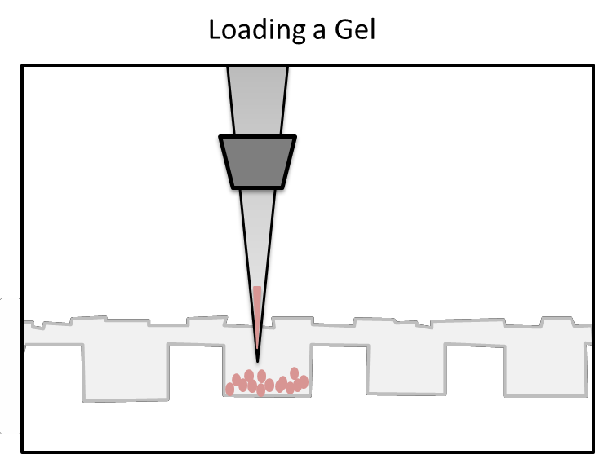
Gel electrophoresis
Retrieve the PCR reaction tubes from the PCR machine and microcentrifuge 5 seconds
To each tube add 5 µl of loading dye to each sample. Mix by pipetting up and down.
Load gel by pipetting 10 ul of the solution into each
of the wells.
Write down the order in which you loaded the
samples.

Slide 42
Gel electrophoresis
Attach the cover to the electrophoresis apparatus matching the color coded cables and electrodes (e.g., red to red and black to black).
Connect the color coded cables to the power supply. Turn the power supply “ON” and set the voltage to “100V.” Press “RUN.”
Look for bubbles to make sure it is working
properly.
Let samples until the loading dye has moved about ¾ of the way down the gel (about half an hour).
Dr. Gregory’s presentation

Slide 43
Gel electrophoresis
Turn off the power supply and remove cover of
electrophoresis apparatus.
Wearing gloves, pick up the gel and tray and drain the liquid into the electrophoresis apparatus.
Carefully transfer the gel on its tray to the UV
transilluminator. Turn off the room lights.
MAKE SURE THE LID TO THE TRANSILLUMINATOR IS CLOSED and then turn on the UV transilluminator. View the gel and photograph using a cell phone camera.
Turn off the UV transilluminator, discard the gel in a waste bag provided by your teacher and wipe the transilluminator with paper towels.

Slide 44
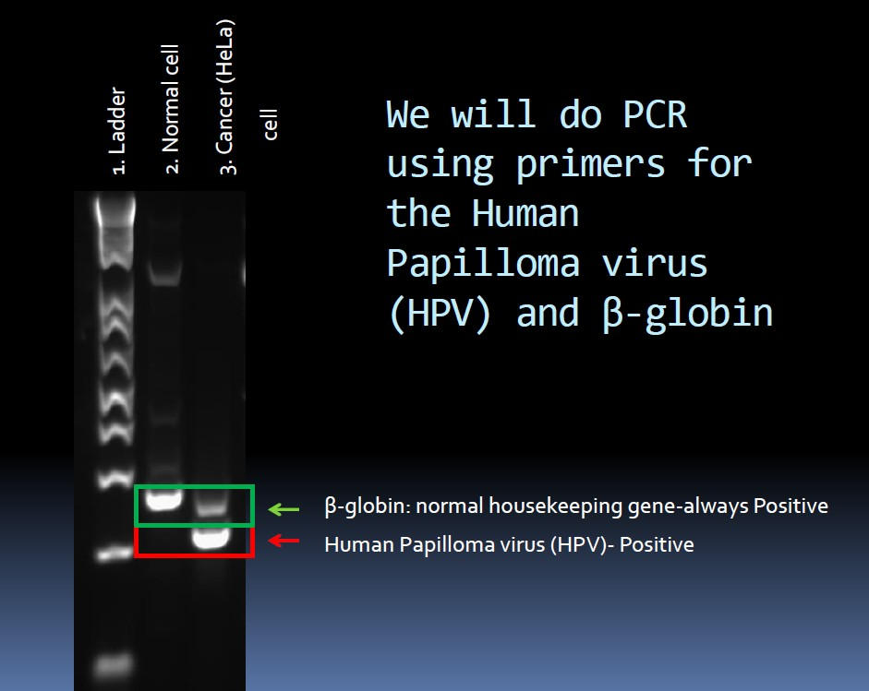
Typical PCR
Results
300 bp
200 bp

Slide 45


Slide 46


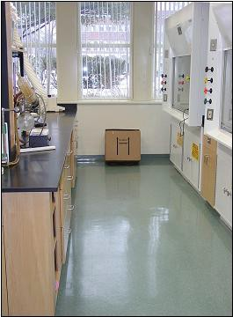
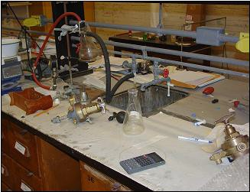
Housekeeping
EATING and DRINKING are not permitted in labs that contain biological, chemical or radiological materials
Dispose of trash in the appropriate container when it is generated to prevent accumulation
Do not place empty bottles or other hazards in walkways
Keep chemicals and glassware away from the edges of countertops
Immediately clean up any spills
Good Housekeeping
Poor Housekeeping

Slide 47

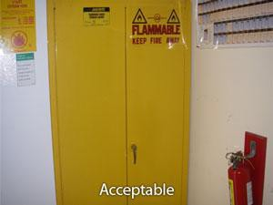
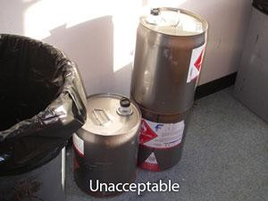
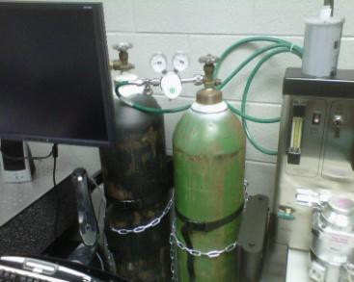
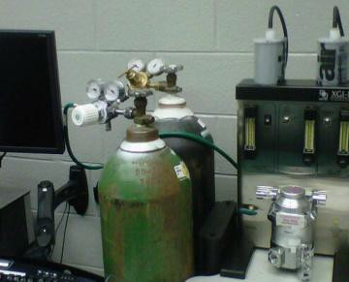

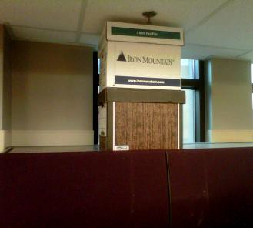
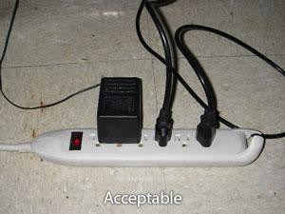
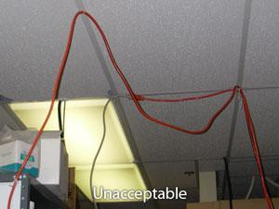
Fire Safety
Know the location of the nearest fire extinguisher and emergency exits
During a fire, use stairs, not elevators
Flame cabinet is required for storage of 10 Gal. or more of any flammable substance
Compressed gas cylinders must be secured
Electrical cords should be free of
breaks or fraying
In the event of an alarm:
  Secure any material that left unattended would pose a hazard
  Exit properly
Acceptable
Unacceptable
Acceptable
Unacceptable

Slide 48

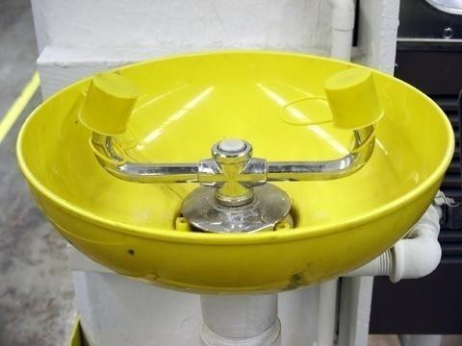
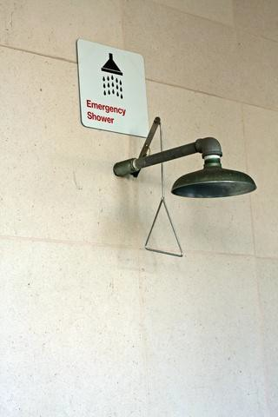
Eyewash and Showers
Know where the nearest eye wash and emergency shower stations are
If you aren’t sure or don’t know how to use them, ask your
supervisor

Slide 49














Hazard Information
Be aware of hazard labels on entry doors and on the doors
of refrigerators, freezers, microwaves and dewars
You should be wearing the correct Personal Protective Equipment (PPE) before opening any door with a hazard label on it
MSDS – Material Safety Data Sheets
Include chemical and physical properties
Toxicity and health effects
Compatibility, safe handling and storage
Spill and fire response

Slide 50

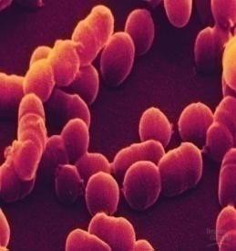
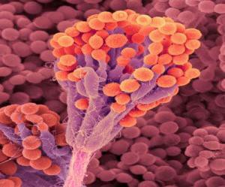
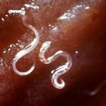
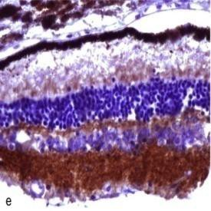
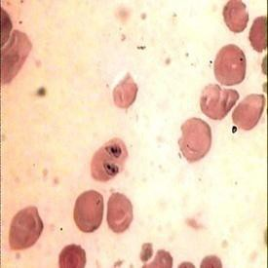

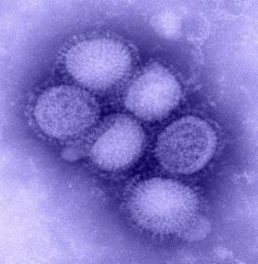
An agent of biological origin that has the capacity to produce deleterious effects in humans, such as microorganisms, toxins and allergens derived from those microorganisms, and allergens and toxins derived from higher plants and animals.
Examples
Bacteria
Fungi
Parasites
Prions
Rickettsials
Toxins
Viruses

Slide 51

A/BSL-1
A/BSL-2
A/BSL-3
A/BSL-4
Low individual risk (non-infectious to healthy adults)
Moderate individual risk
(Not generally severe,
High individual risk
(Treatment may or
Severe individual risk
(Treatment often not available)
treatment usually available) may not be available)
Low risk to community
Low risk to community Low risk to community High risk to community
Examples
E. Coli lab strains
(e.g., DH5α, K12)
Mice Rats Rabbits
Human cells, fluids, tissues
NHP cells, fluids, tissues Lentiviral vectors Rhesus Macaques Animals infected with some BSL2 agents
M. tuberculosis West Nile virus Francisella tularensis Yellow fever virus Monkeypox virus
Animals infected with BSL3 agents
Ebola virus Lassa virus Marburg virus
Animals infected with BSL4 agents

Slide 52
A/BSL-1
A/BSL-2
A/BSL-3
A/BSL-4
Lab coats, gowns, etc.
Eye protection
Latex or nitrile gloves
Lab coats, gowns, etc.
Eye protection
Latex or nitrile gloves
Change when contaminated
Double glove when necessary
Remove gloves and wash hands after working
Do not re-use gloves
All manipulations performed inside a BSC
Full protective clothing that must not leave the lab
Eye protection
Latex or nitrile gloves
•BSL-3 work practices Appropriate respiratory protection
All PPE indicated up to and including BSL-3
Positive-pressure suit
Special facility engineering features

Slide 53



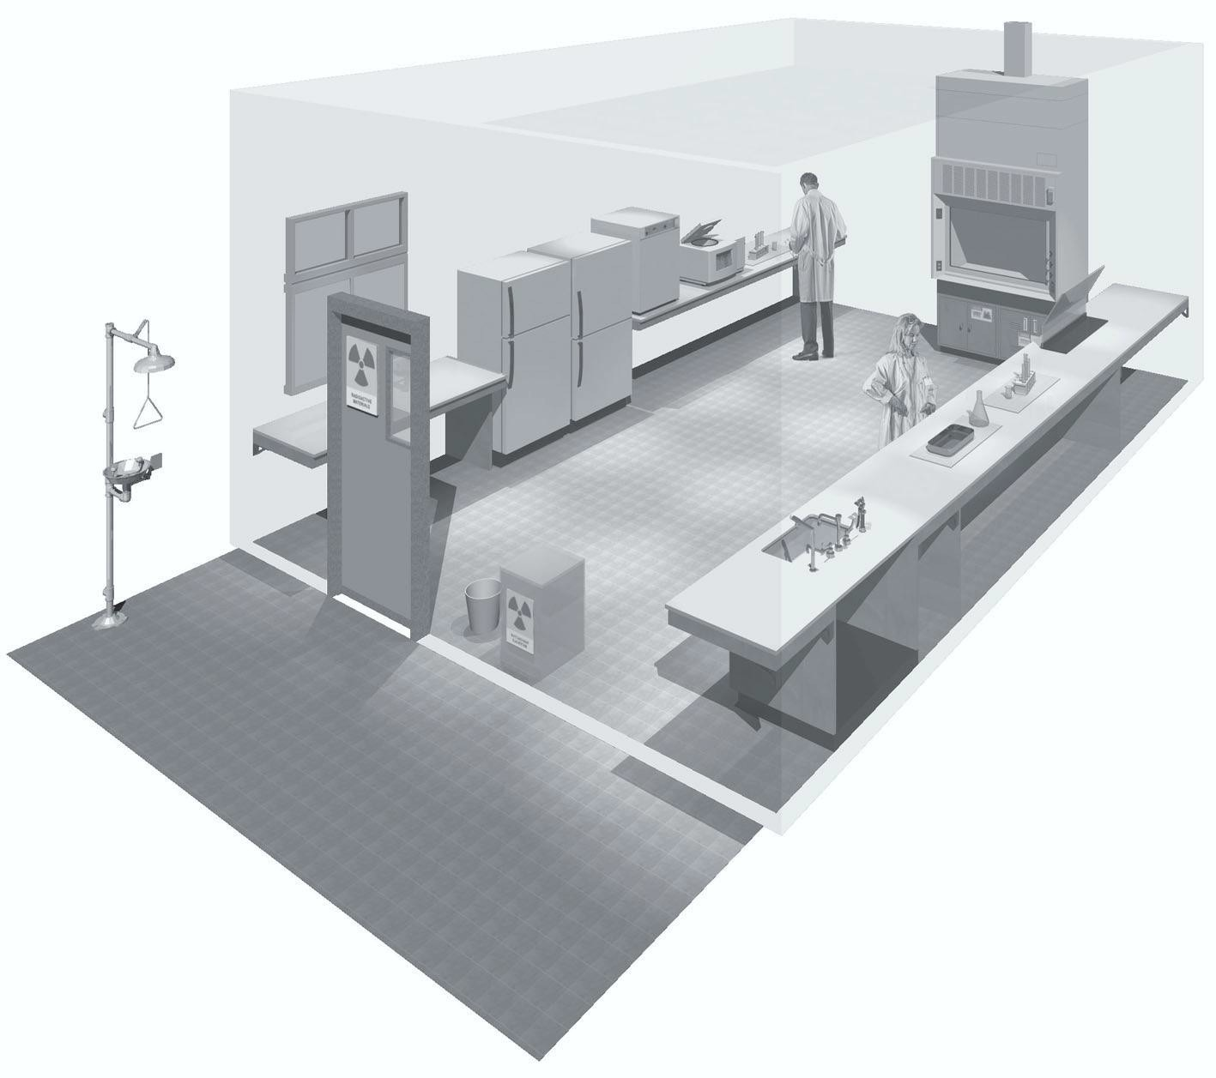
Laboratory has doors to limit traffic
Hand washing sink is available
Work surfaces are easy to disinfect

Slide 54

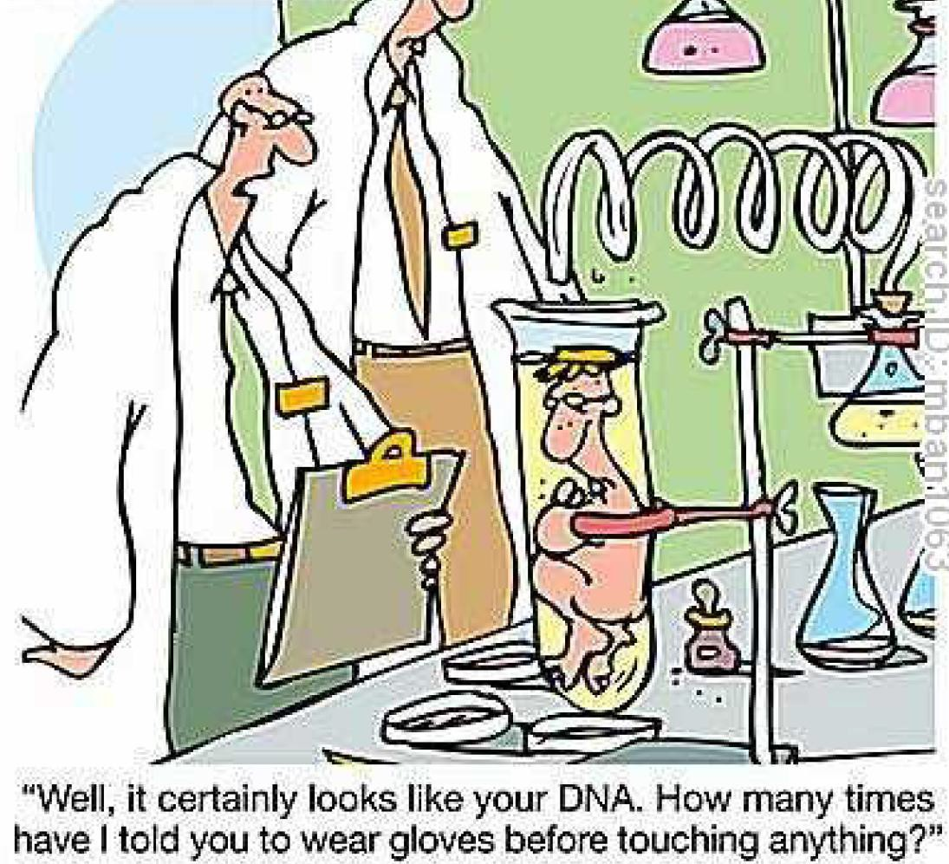
Limit access when working
No eating, drinking, applying cosmetics or handling contact lenses
No mouth pipetting
Gloves must be worn and lab coats and protective eyewear are recommended
Minimize splashes and creation
of aerosols
Disinfect waste and work surfaces
Biological waste should be placed in a biohazard disposal box, labeled, and placed outside for pickup when ¾ full

Slide 55

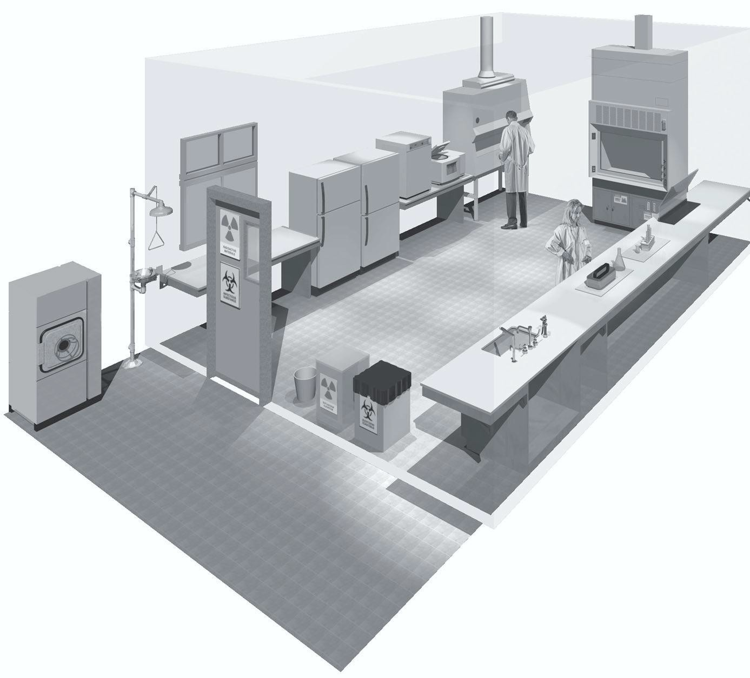
All BSL-1 requirements, plus:
Autoclave is available
Eyewash is present
Signage is posted
Biological waste stream is separate

Slide 56


All BSL-1 practices, plus:
A supervisor must limit access to those who are trained and approved
Policy for handling sharps must be
implemented
Laboratory equipment must be routinely decontaminated
Protective lab coats or disposable
gowns must be worn
Laboratory-specific Biosafety manual must be available in the lab

Slide 57




Hand Washing
All laboratories are required to have a sink available for hand washing
Wash hands for 15 seconds using warm water and mild – preferably liquid – soap
Rinse with warm
running water
Dry with disposable paper towel

Slide 58


Hand Washing
Alcohol-based hand sanitizers are an alternative to hand washing
Sanitizers are effective against common clinical microbes, but have not been tested against laboratory pathogens
Hand washing is preferred

Slide 59


PPE
Gloves
Latex or nitrile gloves should be used for all handling of biological materials
Double gloves may be needed in some circumstances in order to avoid exposure or contamination
They type of gloves necessary and the frequency of changing is specific to your work and should be indicated in lab-specific training
Gloves must never be worn
outside of the work area

Slide 60


PPE
Eye and Face Protection
Wear protective eyewear when conducting procedures that have the potential to create splashes of microorganisms or other hazardous materials
People who wear contact lenses should also wear eye protection
At BSL2 and above, eye and face protection must be used for anticipated splashes and sprays of infectious materials when the microorganism is handled outside of a biosafety cabinet or other containment device

Slide 61







Sharps precautions
Sharps are any instrument that can puncture, cut or scrape
Use EXTREME caution when working with sharps
Whenever possible, alternatives to sharps – such as
plasticware – should be used
When sharps are necessary, safety sharps should be selected whenever they are available

Slide 62

Work Practices
Examples of Safety Sharps

Slide 63


Sharps precautions
Broken glassware must never be picked up by hand
Pick up broken glass mechanically, using forceps, a brush and dustpan, tongs, etc
Sharps Disposal
Used disposable needles must not be bent, altered, broken, recapped, removed from disposable syringes, or otherwise modified
Always dispose of contaminated sharps in an approved, puncture-resistant sharps container
Dispose of container when it is ¾ full by sealing the container and placing in a biological waste box

Slide 64



Sharps Disposal
Uncontaminated or decontaminated glass may be disposed of in a designated, labeled cardboard box
Box should be sturdy and in good condition
Take care not to overload the box – it should be kept to a
reasonable weight, approximately 25 lbs.

Slide 65


Biological Waste Disposal
To be used for all items contaminated with
human or animal blood, fluid or tissue
Also stocks, cultures or waste from infectious materials or microorganisms
All materials that may be contaminated
with recombinant molecules
Do not place sharps in the biological waste box.
  Sealed sharps containers only may be
placed in the biological waste box
When box is ¾ full or reaches 25 lbs. close and tie liner, securely close lid, label with PI name and room number and place in hallway for pickup

Slide 66




Disinfection and
Decontamination
Disinfection is the process of reducing a contaminant load
Can be accomplished in the laboratory using a 70% solution of ethanol (EtOH) or a 10% solution of bleach (sodium hypochlorite)
All works surfaces and materials should be disinfected before and after use
SOPs for routine decontamination are available at the Biological Safety page of the EH&S website

Slide 67

Disinfection and Decontamination
Decontamination is the process of
removing biohazardous agents
Can be accomplished by physical or chemical means
Is typically done using an autoclave,
utilizing high temperature and pressure
Aqueous solutions such as blood, urine, or microbial cultures must be autoclaved prior to disposal
Place items in a secondary container made of stainless steel or autoclaveable plastic
Larger loads require more time and should be arranged in a way that allows for steam penetration (i.e. not too densely packed)
Do not cap vessels or add excessive liquid to the load

Slide 68


Biological Safety Cabinets (BSCs)
Uses High Efficiency
Particulate Air (HEPA) filters
Does not protect against vapor or fumes, which may damage HEPA filters
Class I:
Inward airflow protects personnel
Exhausts to outside Class II:
Four different types
Protects personnel, materials and environment with
directional airflow and multiple HEPA filters, as pictured
Class III:
Both inlet and exhaust air are HEPA filtered (pictured)

Slide 69


Laminar Flow Hood
Is not a BSC and does not provide personnel protection
Typically used for nucleic acid manipulation or other procedures that are very sensitive to contamination, but that do not pose a risk to personnel
Air flows out toward the user
Not to be used for work with infectious or potentially infectious materials

Slide 70


Chemical Fume Hood
Is not a BSC but does provide personnel protection from chemical fumes by external ventilation
Is not HEPA filtered
Not to be used for work with infectious or potentially infectious materials
Exhaust containing infectious materials creates an exposure risk for the immediate environment

Slide 71


Safe Operation of BSCs
Disinfect cabinets before and after each use with 70% ethanol or 10% bleach solution
After disinfecting the cabinet, load supplies and allow the cabinet to run for 10-15 minutes before beginning work
Supplies should include a small autoclave bag, sharps container and beaker with disinfectant for liquid waste
Your BSC should have a
current certification label

Slide 72


Safe Operation of Centrifuges
Check tubes for cracks, leaks or
chips
Use matching sets of tubes and buckets to ensure that the centrifuge is properly balanced
Check that tubes and cups are sealed and that the rotor is locked and buckets are properly seated
Close lid firmly
When the cycle is finished, allow the rotor to come to a complete stop before opening lid

Slide 73


(LN₂) is extremely cold, -320Fº
Displaces oxygen
Expands rapidly
Protect eyes and skin with
goggles, gloves and shoes
Do not allow LIN to touch bare skin; it will burn
Do not seal containers
Take care when transferring liquid or transporting containers

Slide 74



Bloodborne Pathogens
Bloodborne Pathogens
pathogenic microorganisms present in human blood and other body fluids that can cause disease in humans, including hepatitis B virus (HBV), hepatitis C virus (HCV), and human immunodeficiency virus (HIV).
Other Potentially Infectious Material (OPIM)
materials other than human blood that can contain bloodborne
pathogens and may potentially be infectious
includes HIV-containing cell or tissue cultures or organ cultures and HIV- or HBV-containing culture medium or other solutions
Universal Precautions
blood and certain body fluids of all patients are treated as potentially infectious
All research involving the use of human blood, body fluids, and OPIM is carried out using BSL2 practices and procedures, because it is unknown if these materials contain bloodborne pathogens

Slide 75



An exposure is contact with blood or other infectious or potentially infectious materials
  For example, needlesticks or scrapes and cuts with contaminated sharps
  If you’re not sure if you’ve had an exposure, check for punctures in your glove. If the glove is broken, assume an exposure has occurred
  Contact with broken skin through cuts or rashes
  Splashes to the eyes, nose or mouth

Slide 76
If you have an exposure:
  Stop what you are doing
  Thoroughly wash the affected area with soap and warm water for 15 minutes using a massaging motion
  For eye splashes, go to the nearest eyewash station and
rinse with plain water for 15 minutes
If you need medical attention:
Call 911and tell the operator your location, name, nature of the injury
Then call the University Police at 568-8999
After receiving the needed medical attention:
  Notify your supervisor
  Contact the Department of Human Resource Management at 568-3916

Slide 77


Biological Spill Response
  Alert others in the area, including your supervisor
  Put on appropriate PPE, then
Cover the spill with paper towel(s)
Disinfect by pouring a disinfectant around the perimeter of the spill and allowing to stand for 20 minutes
Clean by wiping up with paper towel(s)
Disinfect by spraying and wiping down with disinfectant and paper towel
If you are unsure of what to do or uncomfortable performing the clean-up, or if the spill is larger that you can respond to, call the University Police at 568-8999

Slide 78

If you have any questions or concerns, please contact Department of Environmental Health & Safety
LSUHSC:
Phone: (504) 568-6585
Emergency: 568-8999 Email:safety@lsuhsc.edu

Slide 79





HOW TO MAINTAIN A LAB
NOTEBOOK-
RECORD KEEPING AND HIPAA
Fern Tsien, PhD Department of Genetics LSUHSC

Slide 80

Type and Format
Check with your mentor if he/she requires a specific format depending on the type of research you are doing
Bound book
Loose leaf sheets and folders
Computer/spread sheet
Keep a separate file for printouts, photographs, X-rays, and anything that cannot be taped on to the notebook.

Slide 81
Content
Every page should include:
  Date of the start of the experiment on every page (including year)
  Brief title of experiment or type of clinic
  Statement of purpose: extension of the title with some basic background information

Slide 82
Content, continued
Every page should also include:
Description of experiment (protocol)
List of patients seen (if there is private information such as names, etc. keep this notebook locked- more on this later)
At the end of the entire day, a summary of what you accomplished. Did the experiment work? How can you correct it? Is there any information that you need to look up?

Slide 83

Try to record everything-you
will not be able to remember
everything
Where things are kept
Serum lot number
Antibody titer
Centrifuge speed, model, temperature
Incubation times and temperatures
Number of cells
Agarose or acylamide percentage of a gel
Cell culture conditions
Calculations
Buffer pH
Who is in charge of each large equipment (autoclave, etc.)

Slide 84
Maintenance
Record everything as soon as you can. Do not wait
until the end of the week to record data.
Attach all data, printouts, and X-rays to the appropriate experiments. If they don’t fit, put away everything in a file, properly labeled.
Make tables and graphs. This will help you and your mentor analyze the data. It can also be used for lab meetings and your final presentation.
Make a plan for the following week. Think about
what the data means and what you need to do next.
Ask for help to interpret the data before continuing with the experiment.

Slide 85

Notebook Ethics
The lab notebook belongs to the lab. This means that your mentor will read it, so do not put anything too personal or embarrassing.
Do not “peek” at another lab member’s notebook without asking first. Only you and your mentor should have access to it.
Do not be offended if the mentor looks at your notebook. He/she needs to look at it sometimes to help troubleshoot an experiment.

Slide 86
Notebook Ethics, cont.
Do not dispose of old notebooks you find in the lab, data found in a drawer or on the computer.
If you made a mistake or if you get negative results, record this. Do not be embarrassed and omit recording the data.
Your data is your responsibility. Record it accurately and responsibly.

Slide 87
HIPAA
Health Insurance Portability
and Accountability Act
Federal law passed by Congress in 1996 to ensure patient
confidentiality
Regulations enforced by the US Dept of Health and Human Services
Guidelines implemented in April, 2003
What part do students play in implementing HIPAA?
How does this law affect your role as a
student?

Slide 88
HIPAA regulations were
designed to:
protect individuals’ rights to privacy and
confidentiality
and
assure the security of electronic transfer of
personal information

Slide 89
Working with patient data
Only the people in your lab or clinical group can
discuss the patients or their data.
Take all reasonable steps to make sure that individuals without the ‘need to know’ do not overhear conversations.
DO NOT conduct discussions with patient names in elevators or cafeterias.
Do not let others see your computer screen while you are working on patient data. Be sure to log out when done with any computer file.

Slide 90

HIPAA applies to us all--in
all settings
That means do not discuss patient names at school, at home, on the shuttle buses, as well as the hospitals and clinics.
If you recognize someone in the clinic ( even if it is your best friend), or see a name you recognize in the research or clinical database, keep it to yourself!!!

Slide 91
Why HIPAA?
Genetic advancements - as more is known about our genetic predisposition to diseases, HIPAA will ensure that, for example, an individual is not denied insurance because the company knows that she may eventually develop cancer.
Marketing - as information is more easily captured concerning, for example, the prescriptions we purchase, HIPAA is designed to prevent marketing of unsolicited products or services based on harvested marketing data.
Technology - as information is quickly and sometimes loosely moved around networks, HIPAA standards will hold violators accountable for accidental or intentional ‘interception’ of protected health information (PHI).

Slide 92

Why HIPAA?
The late tennis star Arthur Ashe’s positive HIV status was disclosed by a healthcare worker and published by a newspaper without his permission.

Slide 93

HIPAA Regulations
Give patients more control over their health information.
Set boundaries on the use and disclosure of health
records.
Establish appropriate safeguards for all people who participate in or are associated with the provision of healthcare to ensure that they honor patients’ rights to privacy.
Hold violators accountable through civil and criminal penalties.
Strike a balance when public responsibility requires disclosure of some forms of data--for example, to protect public health.

Slide 94

Conclusions
Write down everything!
Maintain good notes!
Protect patient data!

